Slide 1
Asymmetric encryption
Lecture 5

Slide 2
Cryptography - Review
Encryption or Cryptology – the name means secret writing – is probably the strongest defense in the arsenal of computer security protection.
Cryptography conceals data against unauthorized access.

Slide 3
Encryption Keys
A cryptosystem involves a set of rules of how to encrypt the plaintext and decrypt the ciphertext. The encryption and decryption rules, called algorithms, often use a device called a key, denoted by K, so that the resulting ciphertext depends on the original plaintext message, the algorithm, and the key value.
We write this dependence as C = E(K, P). Essentially, E is a set of encryption algorithms, and the key K selects one specific algorithm from the set.

Slide 4
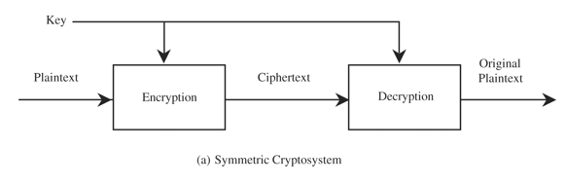
Encryption Keys
Symmetric (single-key or secret) key encryption:
the encryption and decryption keys are the same: P = D (K, E(K, P))

Slide 5
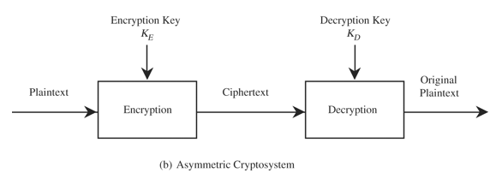

Encryption Keys
Asymmetric (or public) key encryption:
Encryption and Decryption keys come in pairs. A decryption key, $K_{D}$, inverts the encryption of key $K_{E}$, so that P = D($K_{D}$, E($K_{E}$, P)).

Slide 6
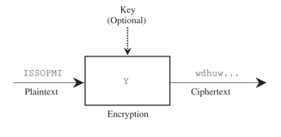
Stream Enciphering

Slide 7
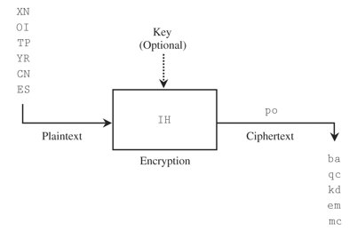
Block Cipher

Slide 8
DES: The Data Encryption Standard
DES is a careful and complex combination of two fundamental building blocks of encryption: substitution and transposition.
The algorithm derives its strength from repeated application of these two techniques, one on top of the other, for a total of 16 cycles.
DES encrypts 64-bit blocks by using a 56-bit key.

Slide 9
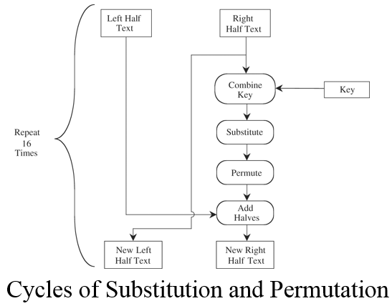
DES: The Data Encryption Standard

Slide 10
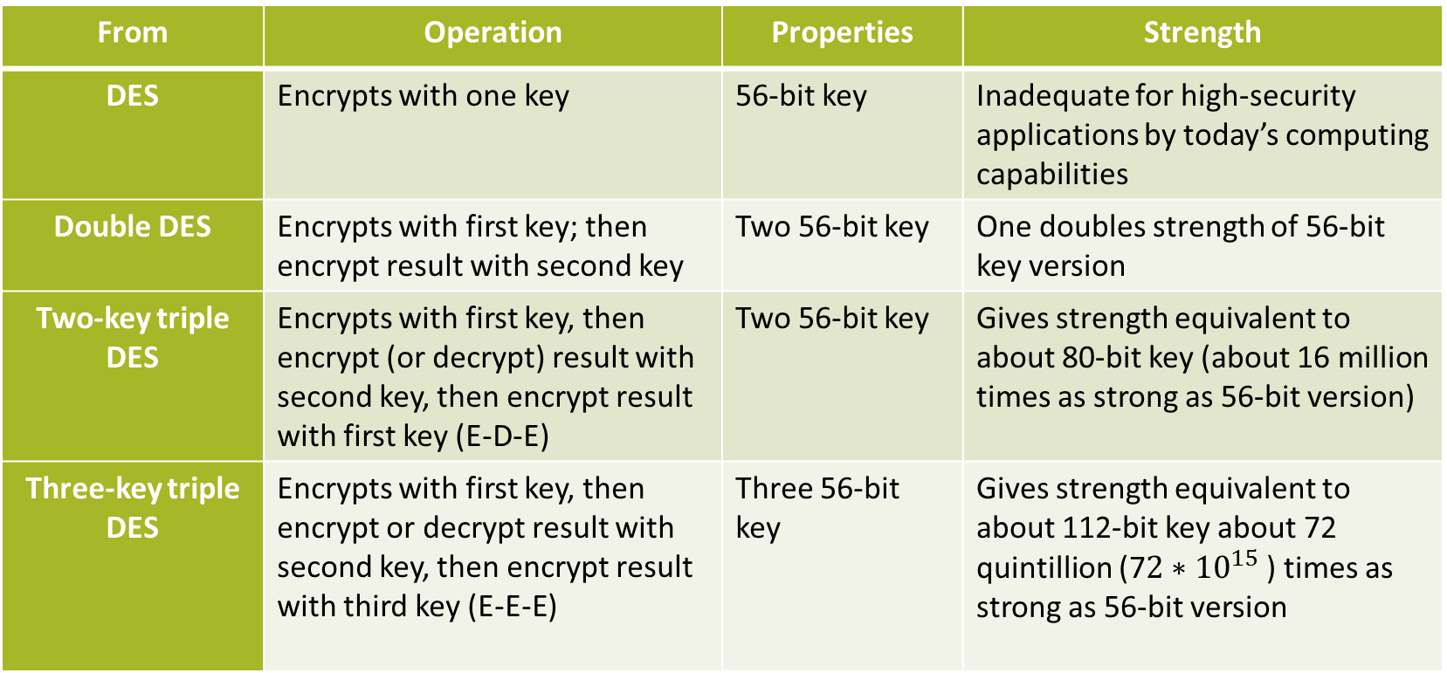
DES: The Data Encryption Standard
From | Operation | Properties | Strength
DES | Encrypts with one key | 56-bit key | Inadequate for high-security applications by today’s computing capabilities
Double DES | Encrypts with first key; then encrypt result with second key | Two 56-bit key | One doubles strength of 56-bit key version
Two-key triple DES | Encrypts with first key, then encrypt (or decrypt) result with second key, then encrypt result with first key (E-D-E) | Two 56-bit key | Gives strength equivalent to about 80-bit key (about 16 million times as strong as 56-bit version)
Three-key triple DES | Encrypts with first key, then encrypt or decrypt result with second key, then encrypt result with third key (E-E-E) | Three 56-bit key | Gives strength equivalent to about 112-bit key about 72 quintillion (7$2∗{10}^{15}$ ) times as strong as 56-bit version

Slide 11
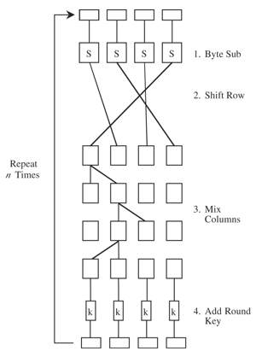
AES: Advanced Encryption System

Slide 12
Comparison of DES and AES
 | DES | AES
Date designed | 1976 | 1999
Block size | 64 bits | 128 bits
Key length | 56 bits (effective length); up to 112 bits with multiple keys | 128, 192, 256 (and possibly more) bits
Operations | 16 rounds | 10, 12, 14 (depending on key length); can be increased
Encryption primitives | Substitution, permutation | Substitution, shift, bit mixing
Cryptographic primitives | Confusion, diffusion | Confusion, diffusion
Design | Open | Open
Design rationale | Closed | Open
Selection process | Secret | Secret, but open public comments and criticism invited
Source | IBM, enhanced by NSA | Independent Dutch cryptographers

Slide 13
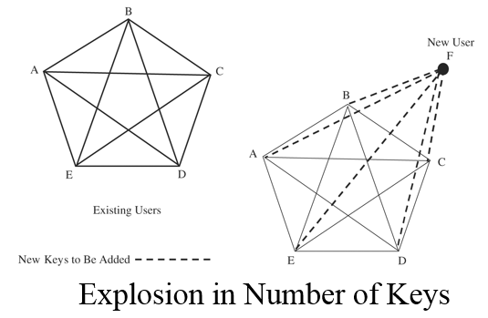
Public Key Cryptography

Slide 14
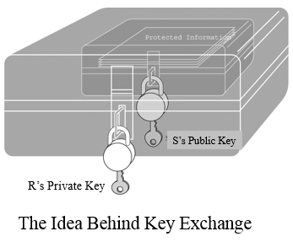
Public Key Cryptography - Characteristics
We can reduce the problem of key proliferation by using a public key approach. In a public key or asymmetric encryption system, each user has two keys: a public key and a private key.

